Slide 1
Report Week 8
SCHOOL OF MECHANICAL AND AEROSPACE ENGINEERING
Doan Manh Hung
Oct 10th, 2014

Slide 2
Orthogonally => Make no resultant
Orthogonally mean the vanishing of all integral of pair product of these function taken over the entire section F.
the beam section as rigid (shell of rigid section) => the stress (normal or tangential) on the cross section of the beam do not change when the external transverse load in the beam element included between the section z= const and z+dx =const is replaced by another node. Statically equivalent to the first.
Under an external load acting in the plane of cross-section and which result in a system of force statically equivalent to zero for each elementary transverse slice => The beam behave a rigid body and, consequently the normal and tangent stress on the cross section due to this load are equal zeros.

Slide 3
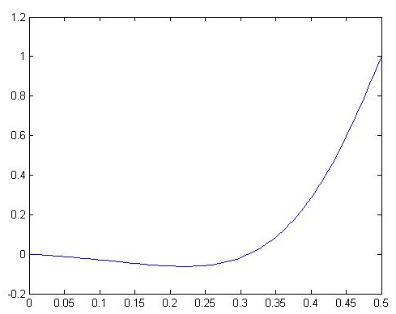
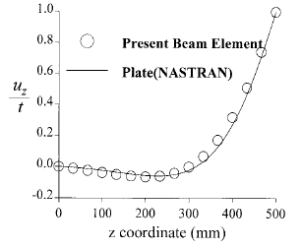
Warping displacement obtained in example 1

Slide 4
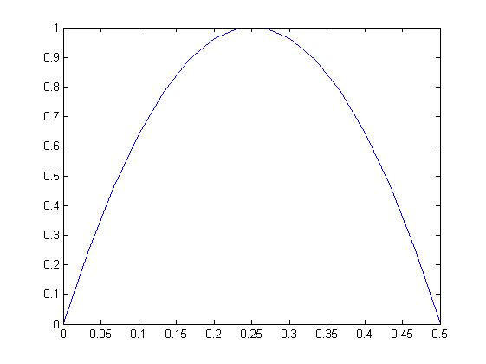
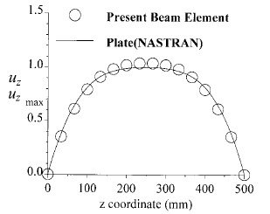
Warping displacement obtained in example 2

Slide 5
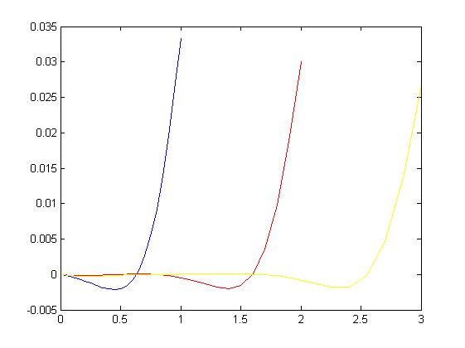
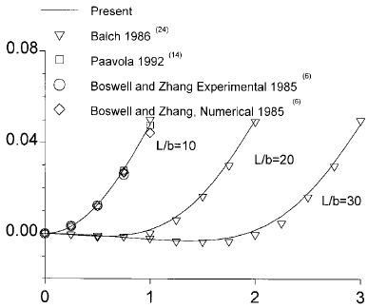
Distortion angle obtained in example 3

Slide 6
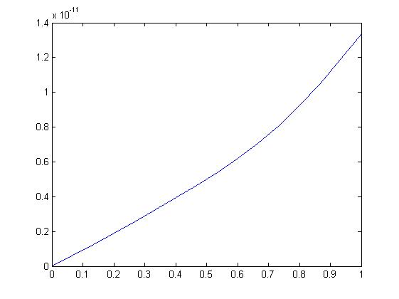
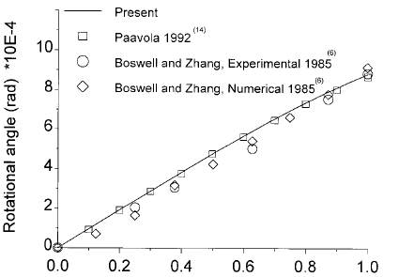
Rotation angle obtained in example 3

Slide 7
Going to do next week: - 1D thin walled beam in Seoul Nat’l Uni. ppt.

